Slide 1
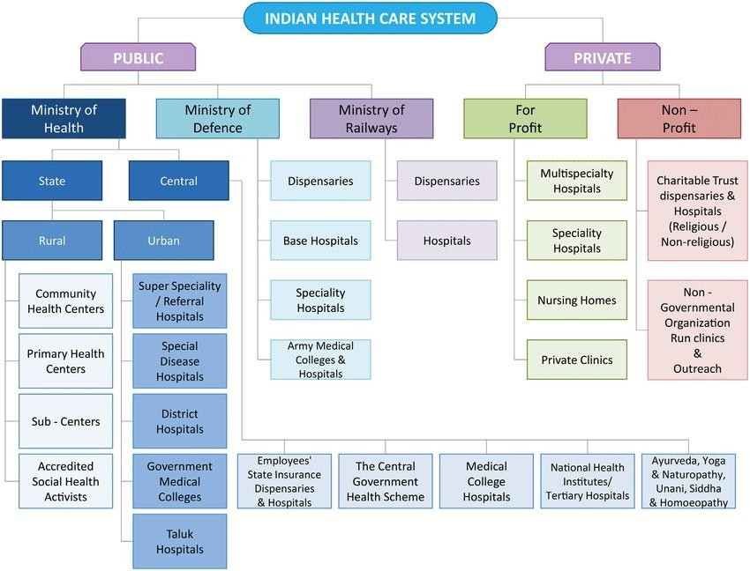
The Indian Healthcare organizational Structure in detail
Notes:
86,216 Cr budget, 23581 Government Hospitals and 22k Central Government Hospitals ,total 80,000 hospitas.66% of GDP goes to health expenditure ,global healthcare rank is 136 and disease and mortality rate is higher, 44,000 pvt,26k public, state 65 % ,Central 45 %. National Medical Commission (NMC) , 11 lakh doctors but only 3 lakh registered

Slide 2
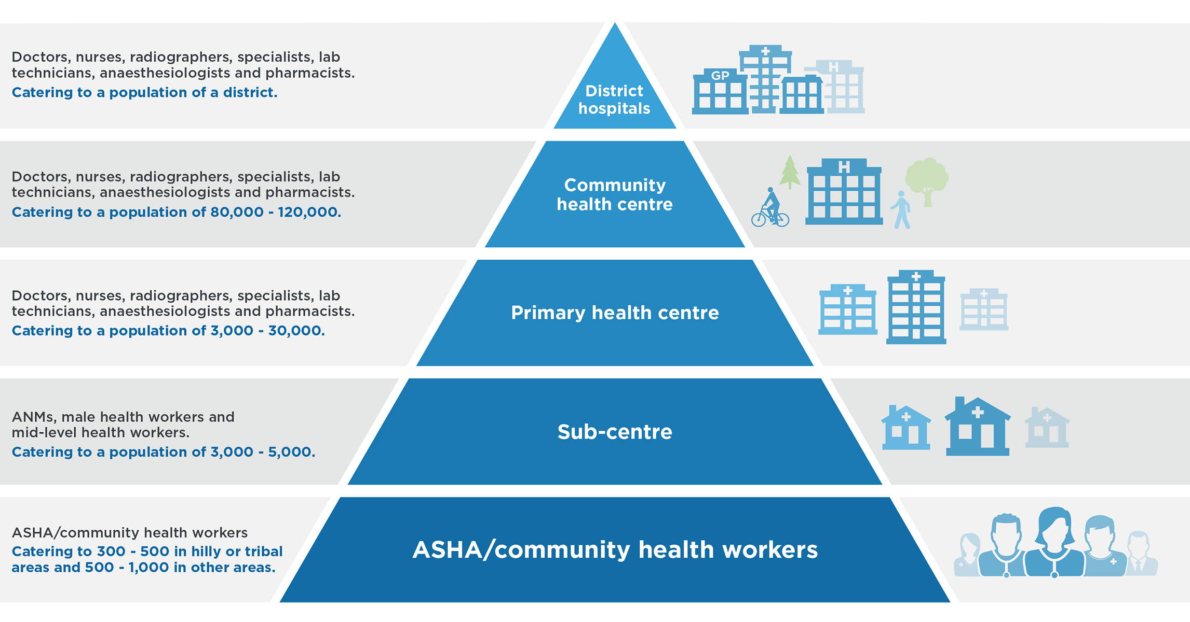
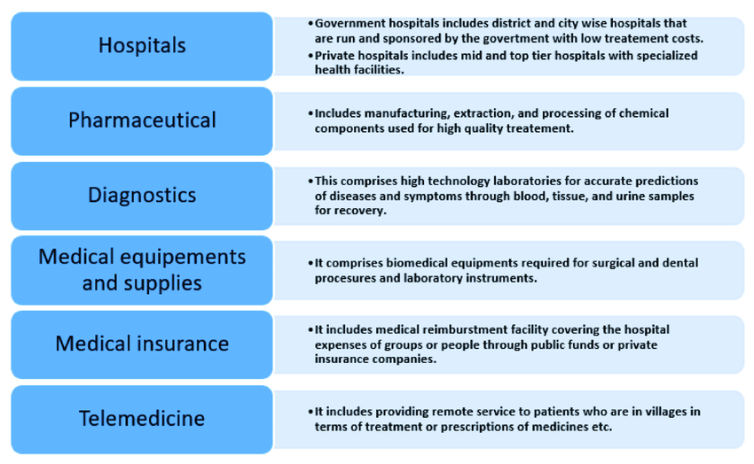
3 Tier Architecture of Indian Healthcare System
Building Efficiencies in Indian Healthcare System Leveraging Generative AI Techniques
Notes:
According to various parameters healthcare in public and pvt ,pvt is btter but costly and discrict level is good,compared to rural, Information and Communication Technology (ICT) in health

Slide 3
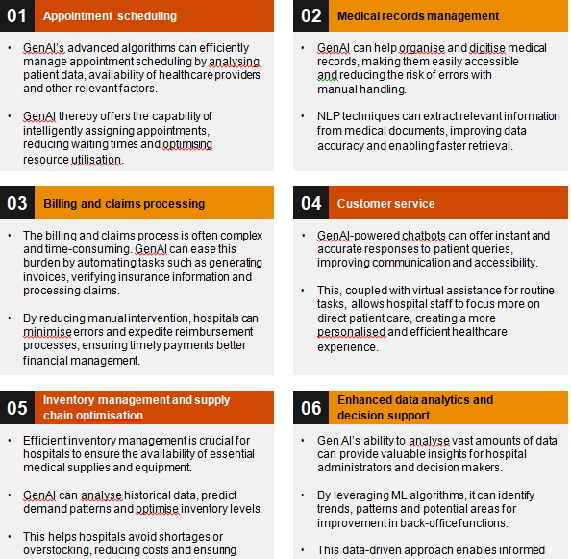

Slide 4
Probable use case for GEN-AI in Indian healthcare Ministry
Indian health ministry department Budget allocation and management
Prevention methods for any Epidemic management
Planning and distribution of resources. Designing Infrastructure to contribute to healthcare system and its distribution Identify Areas of weakness and states lacking resources
Medical Transcript Designing and identifying emergency measures to address various healthcare issues
To have perpetual dialog with W.H.O and other countries like European Union, US Healthcare Federal System. Supply chain management during emergency
Insurance policies-Gen AI can study health issues then it can forecast claims and according to that can decide premium .
Generative AI can help infrastructure of Medical education colleges.

Slide 5
USE Cases
Gen AI can be used to Encourage and tie up with Startup & promote marketing and Management, can recommend financing of healthcare startup
Gen AI help in create public awareness about health policies and yojana, instructional content and distribution
Malnutrition, health issues Death and other issues can be tracked and accordingly create policies and do planning

Slide 6
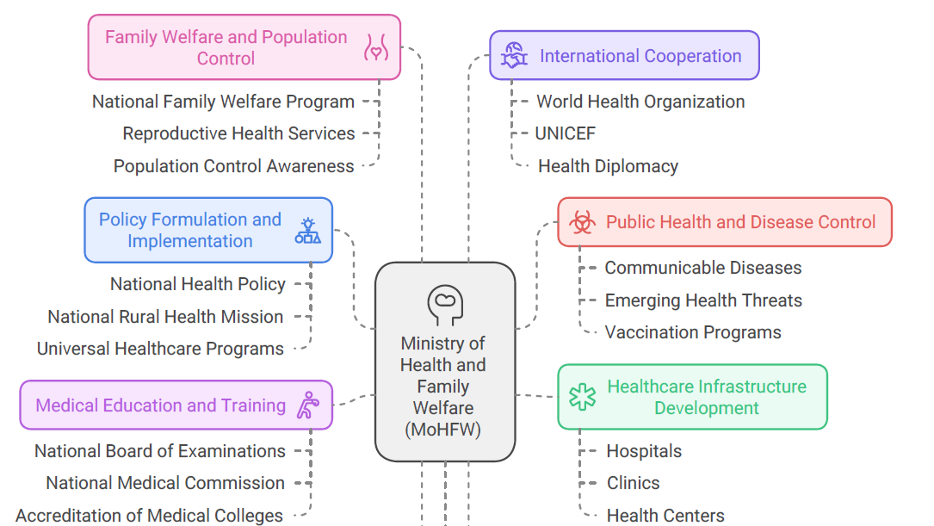
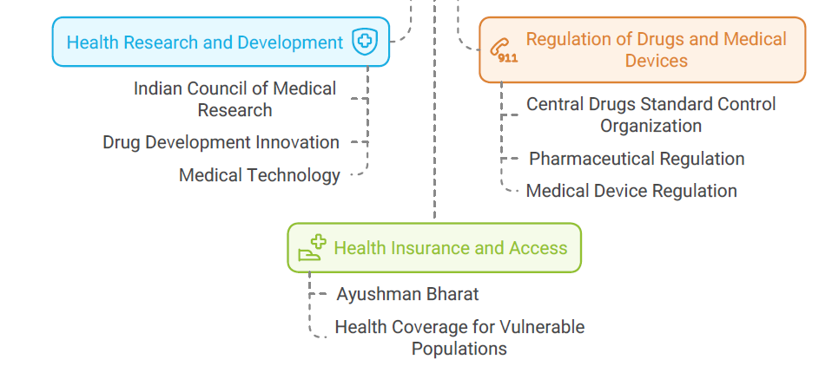
Functions of Indian Healthcare Ministry

Slide 7
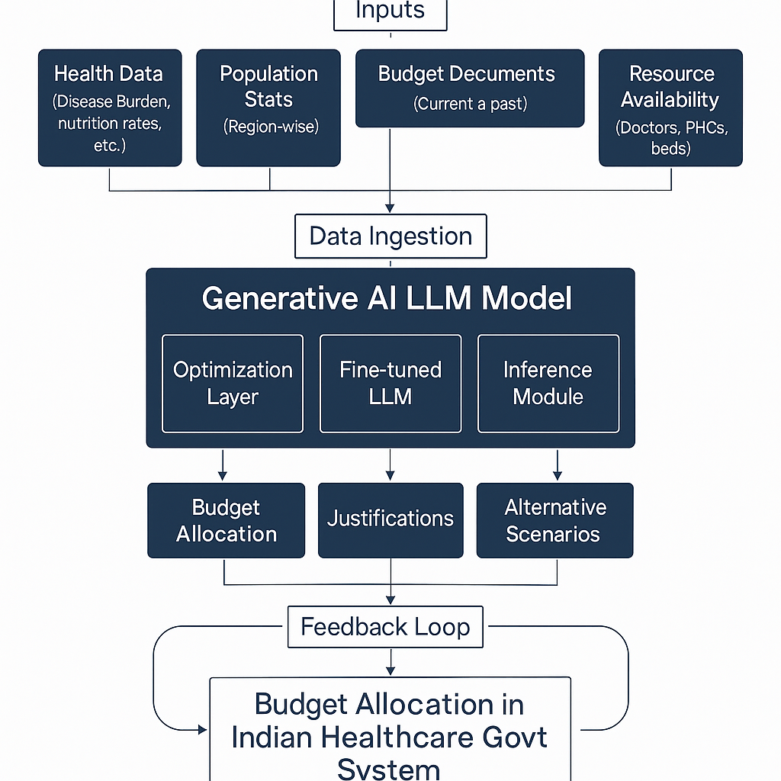
Budget Allocation Model

Slide 8
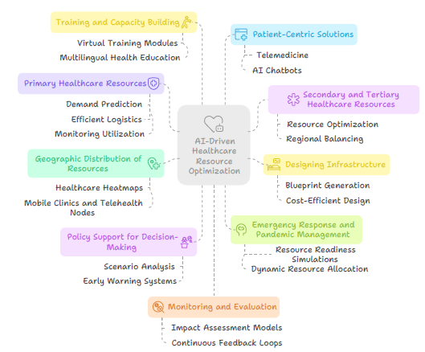

Slide 9
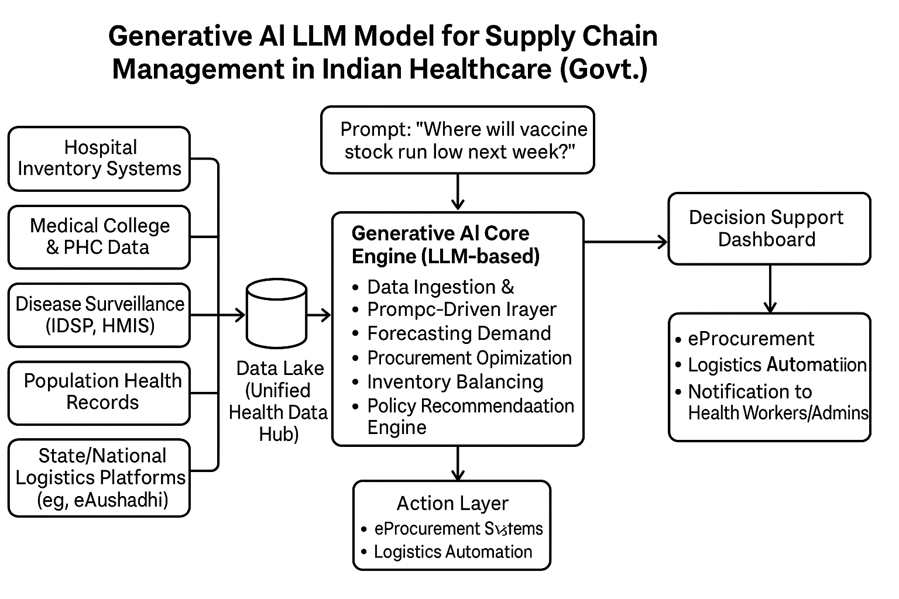
SCM-MODEL

Slide 10
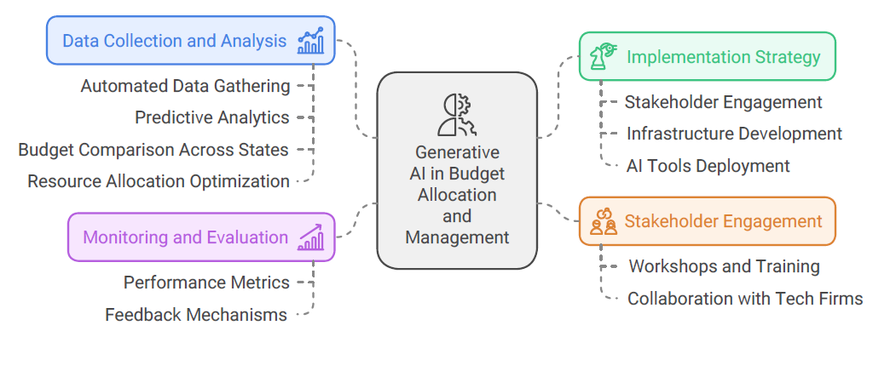
Budget Allocation with GEN AI

Slide 11
Gen AI IN INDIAN healthcare
Hospital management system, infrastructure and integration
Supply chain management
Regulatory and standard compliance
Process optimization and quality improvement
Healthcare administration management
Capacity planning and human resource management
Financial management

Slide 12
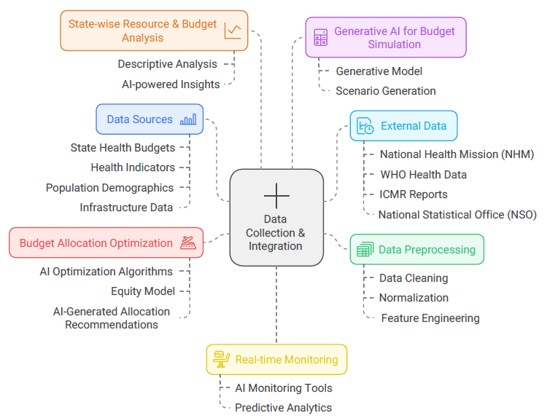
Various Stackholders for data analysis

Slide 13
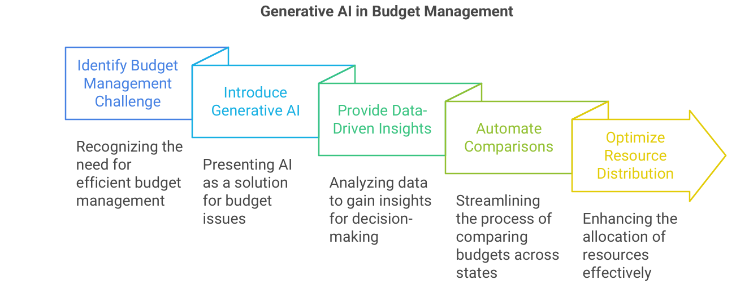
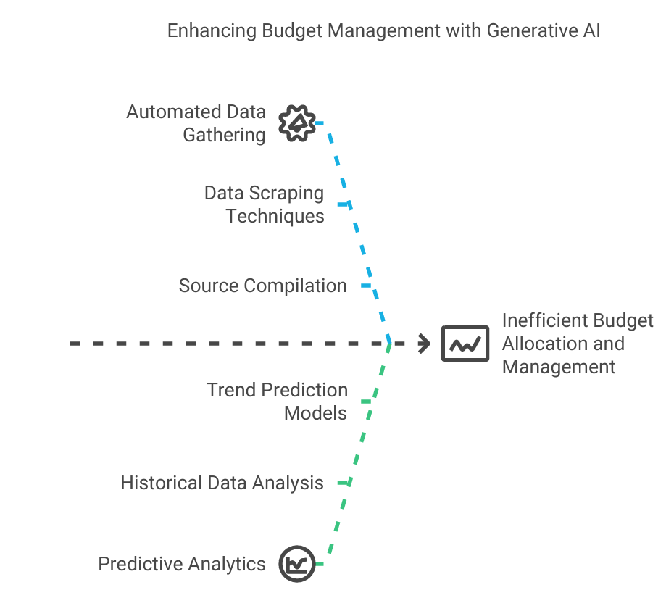
Gen AI in budget Management

Slide 14
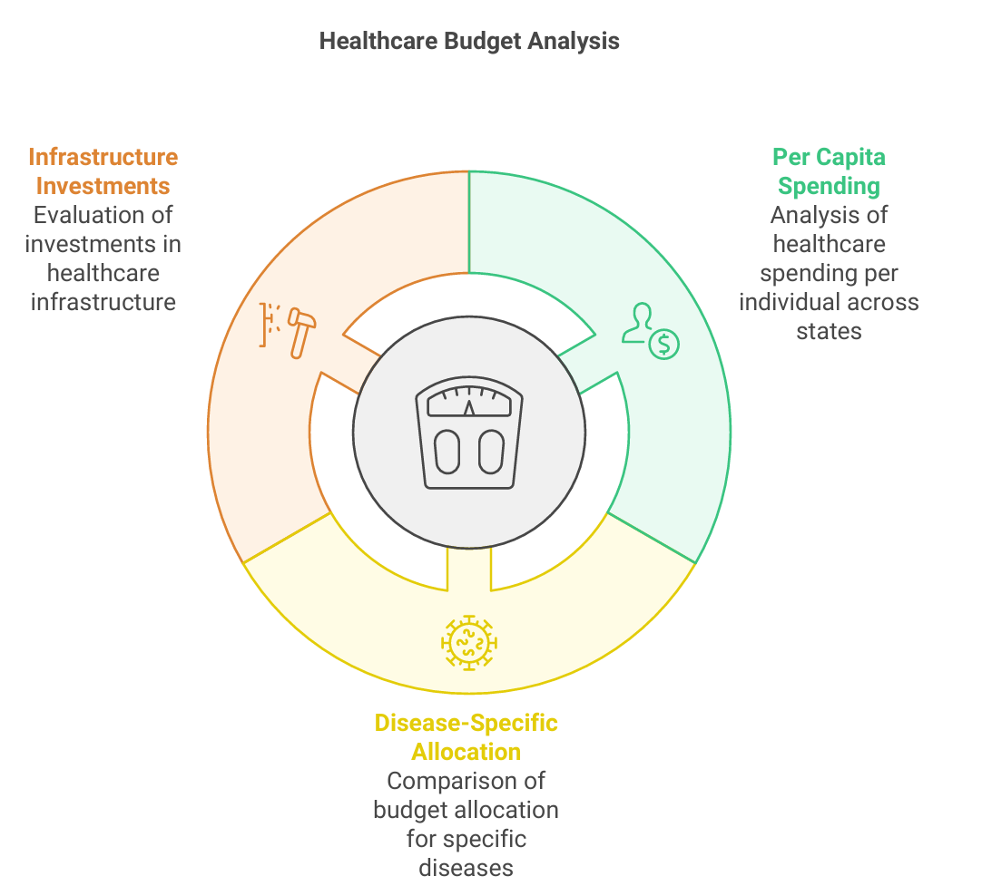
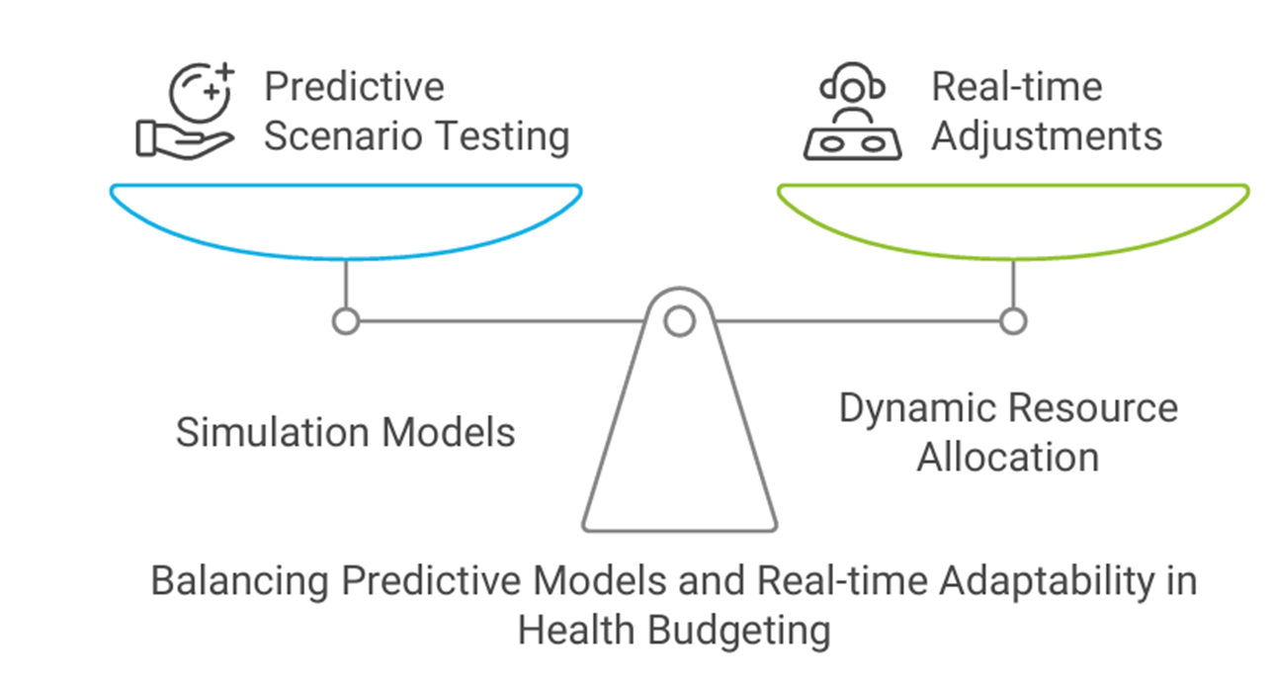
Gen AI in budget Prediction for distribution

Slide 15
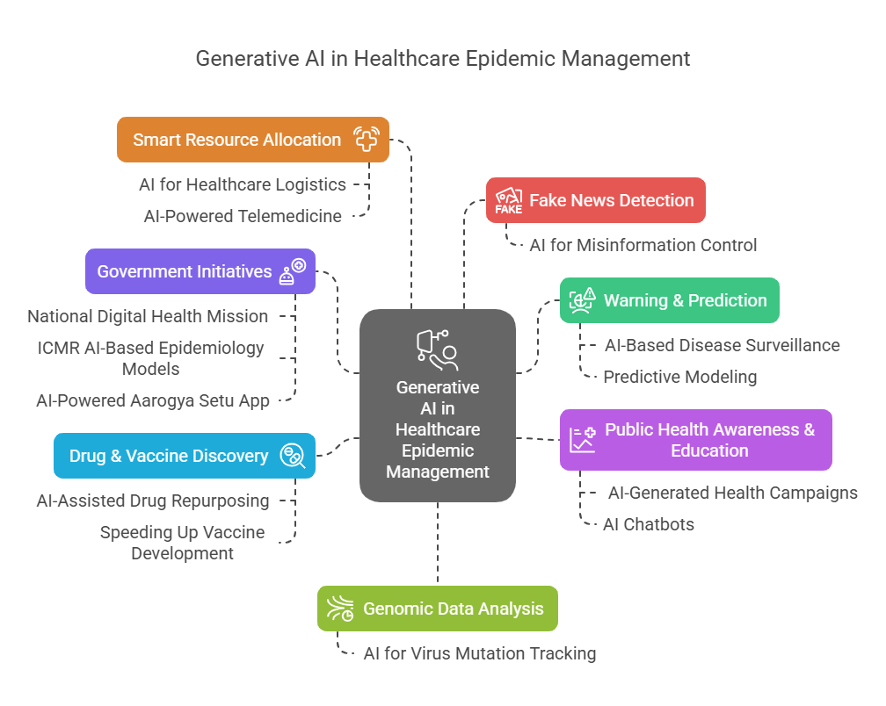

Slide 16
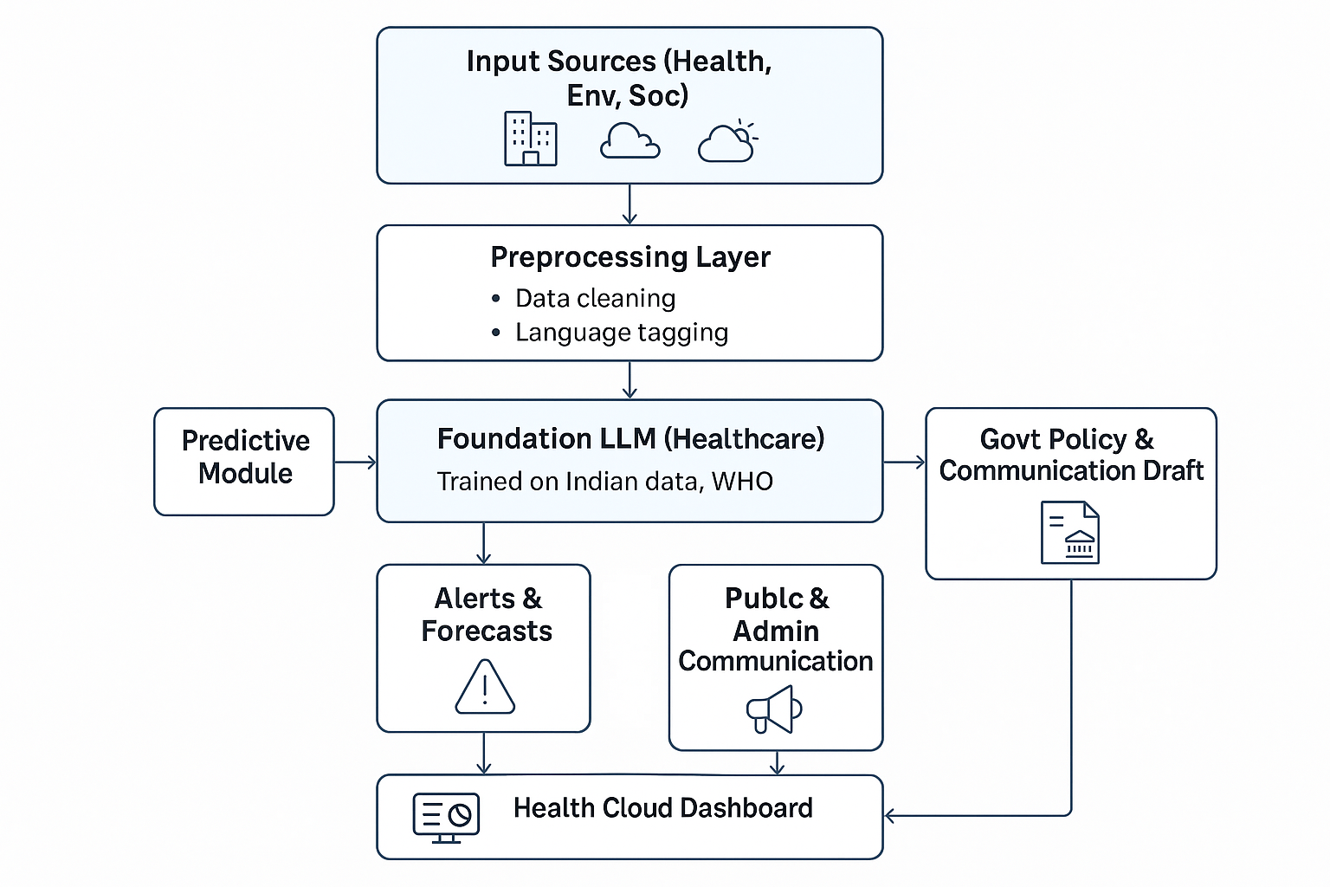
Epidemic and health management-model

Slide 17
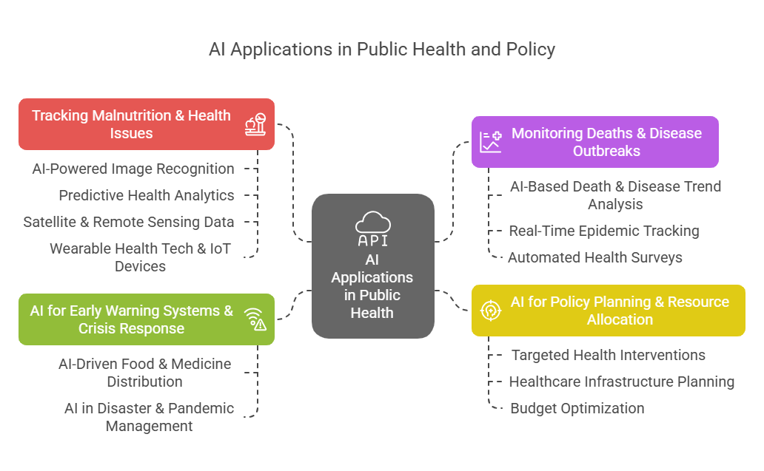
Future prediction for epidemic and health management

Slide 18
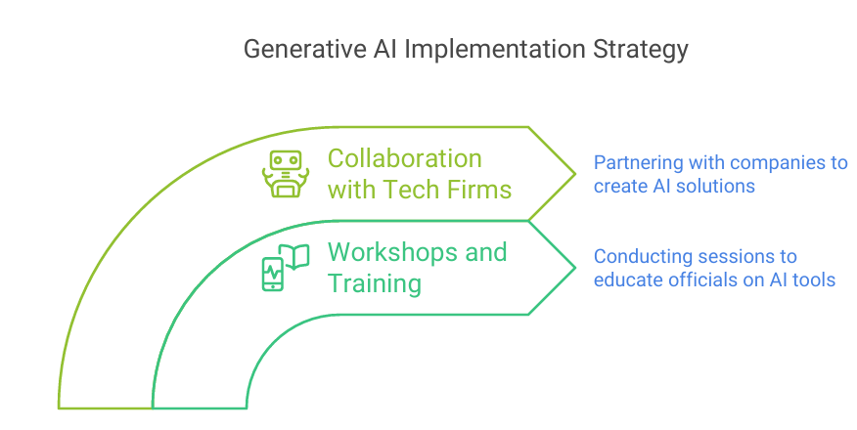
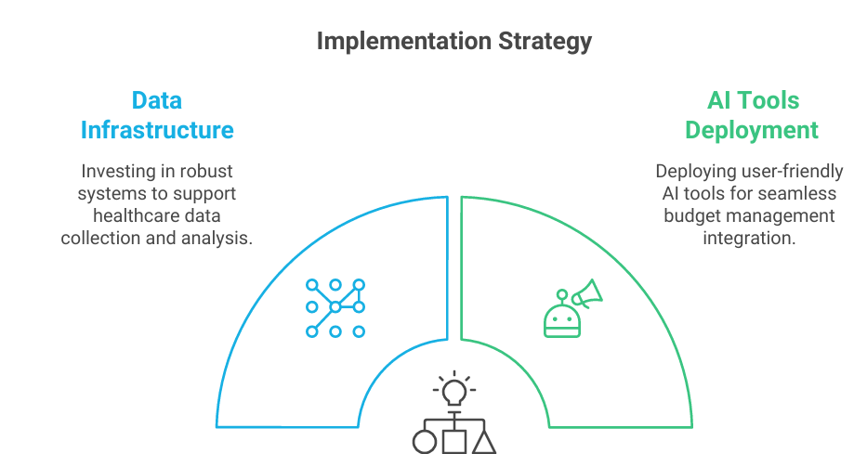

Slide 19
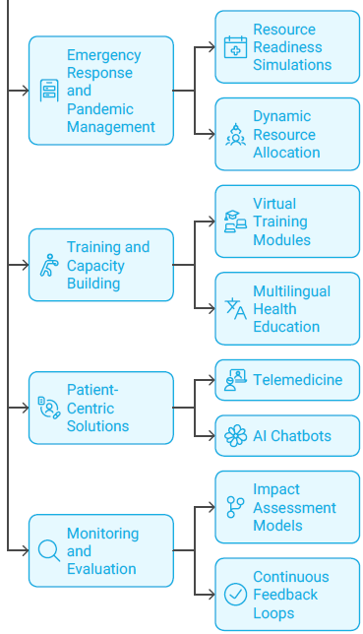
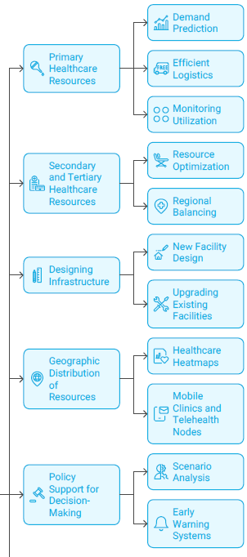

Slide 20
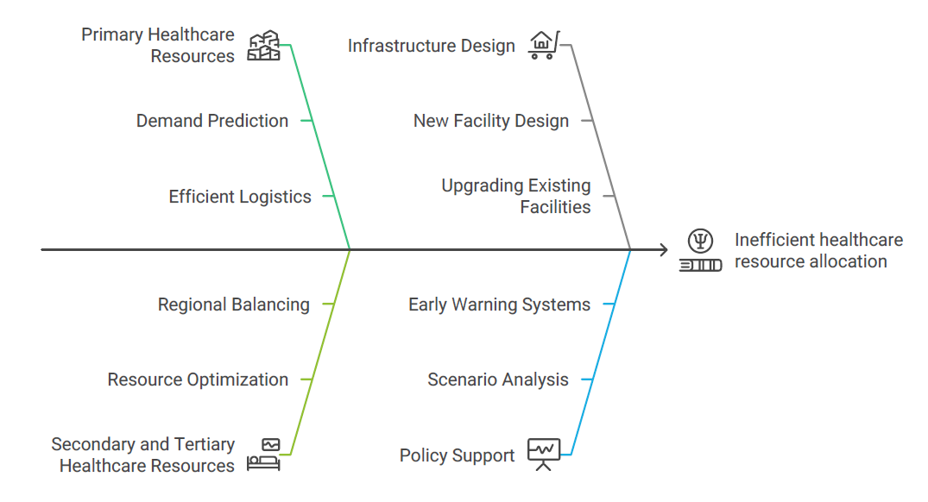
Resource Allocation

Slide 21
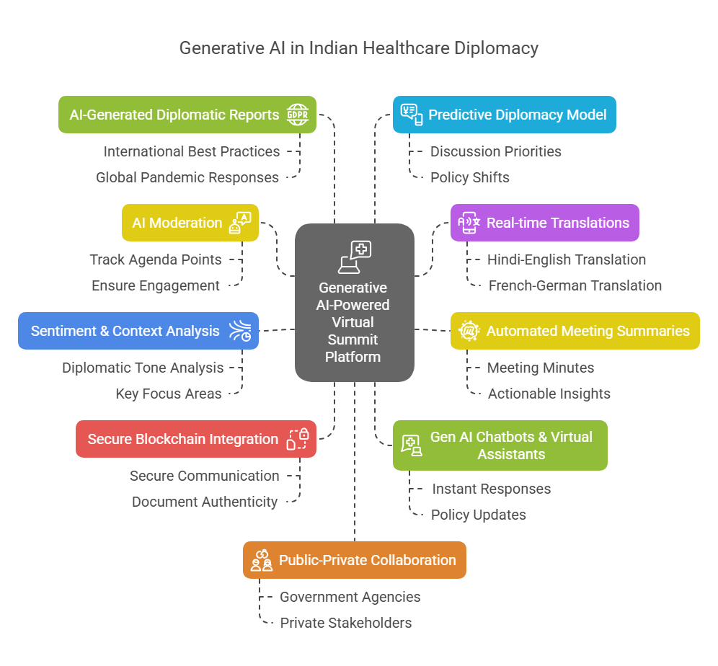
External International Submit

Slide 22
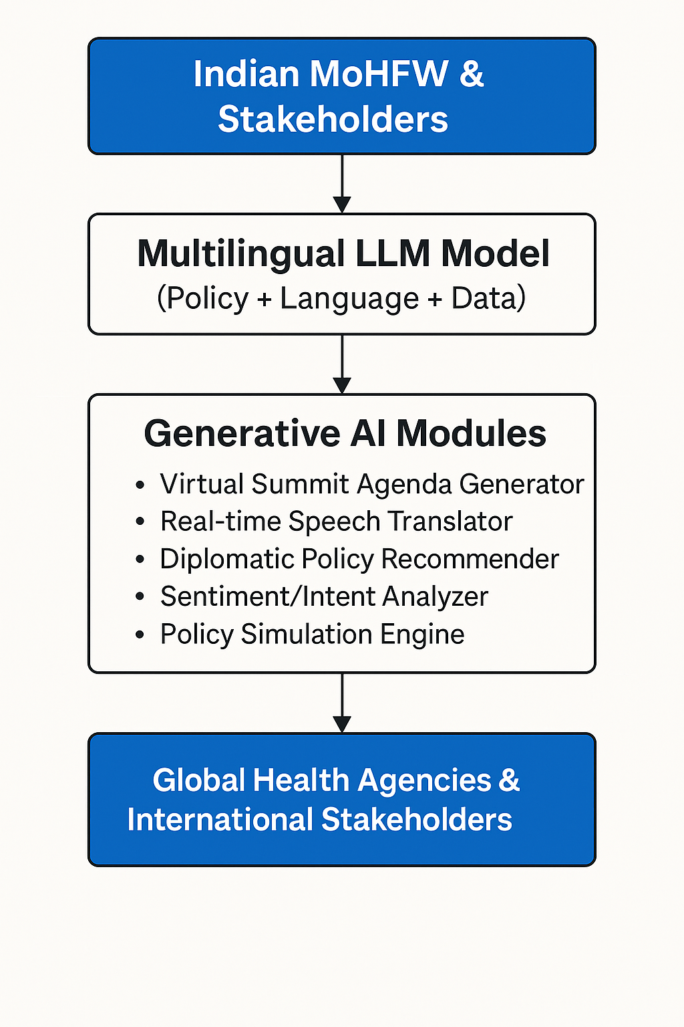
Healthcare Diplomacy

Slide 23
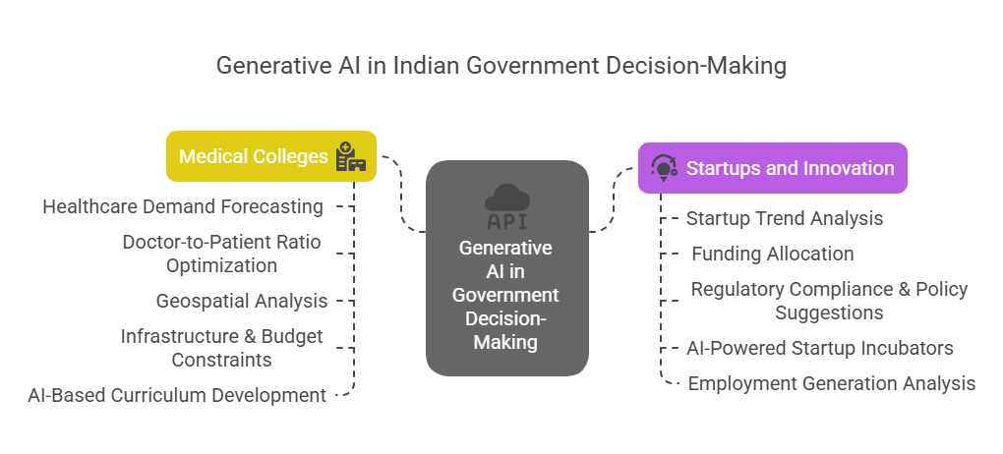

Slide 24
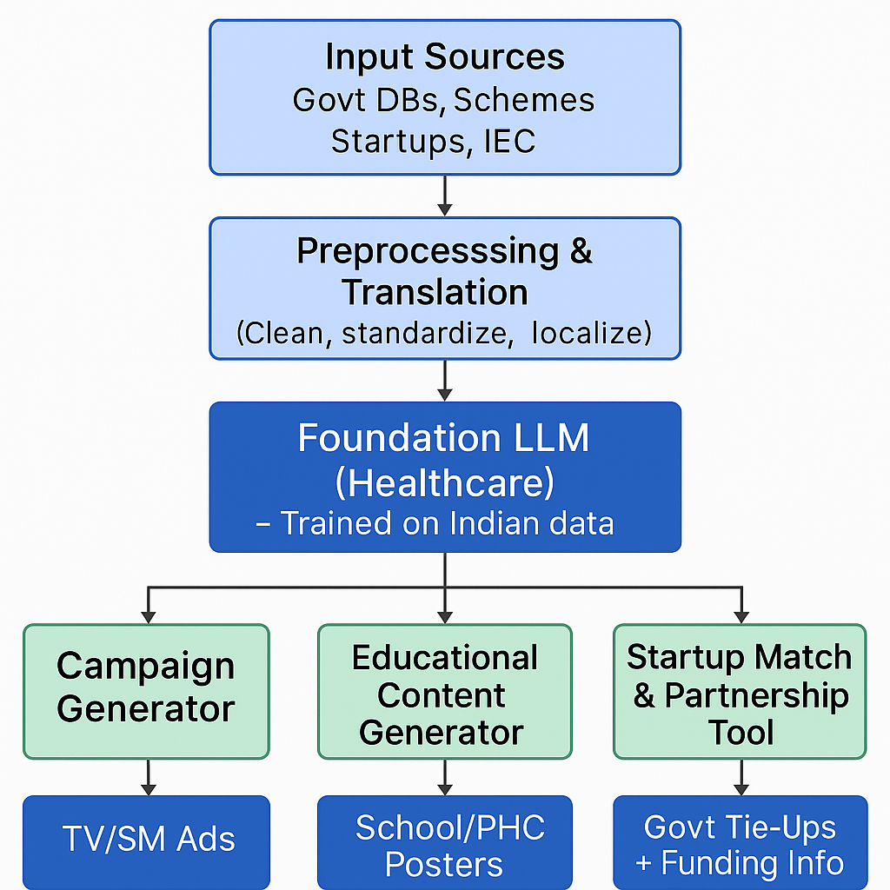
Educational & marketing model

Slide 26
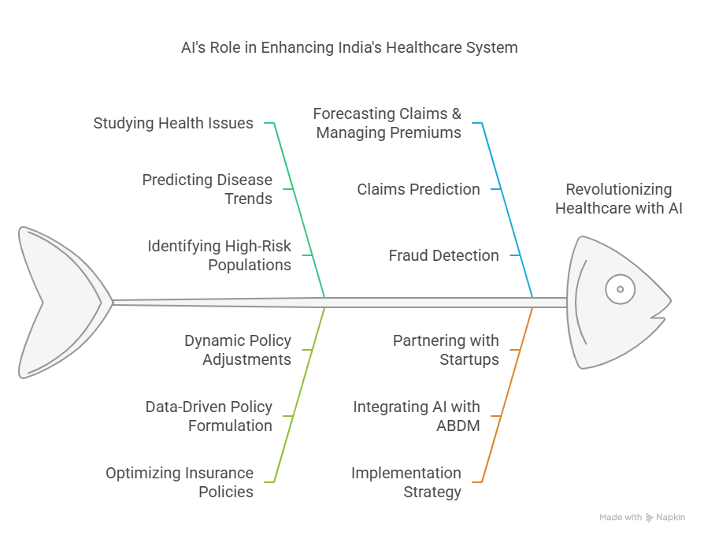
Insurance

Slide 27
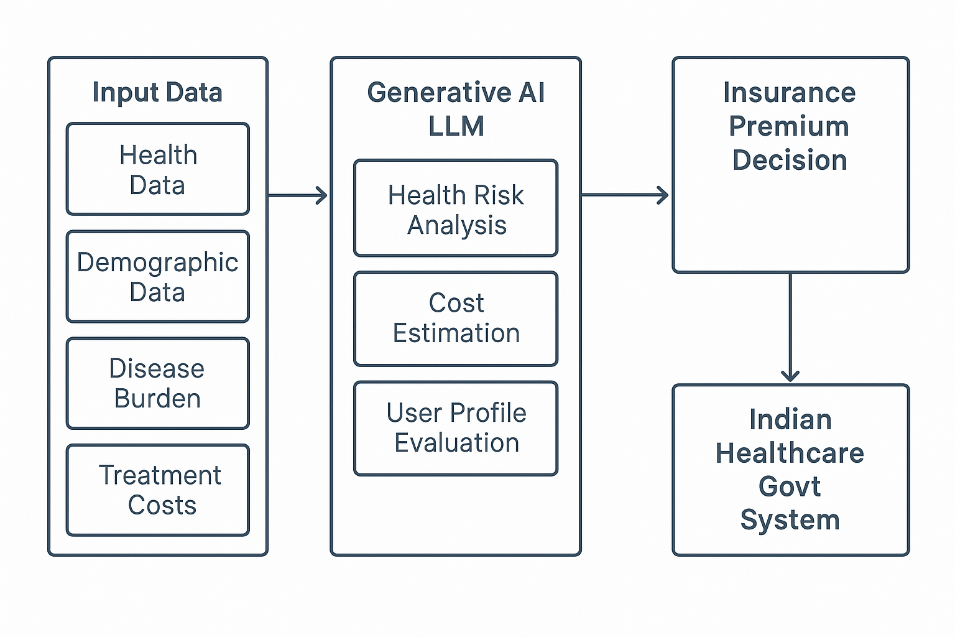
Insurance -model

Slide 28

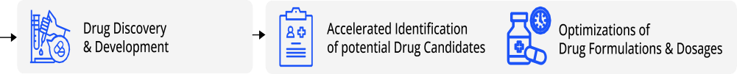
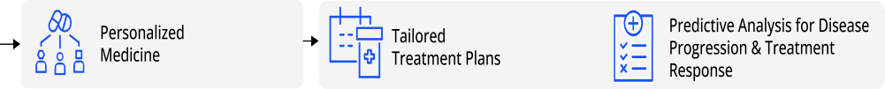
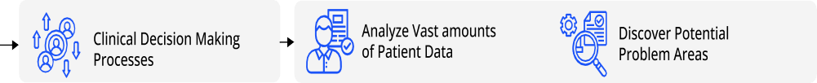







Probable Use cases
Building Efficiencies in Indian Healthcare System Leveraging Generative AI Techniques

Slide 29
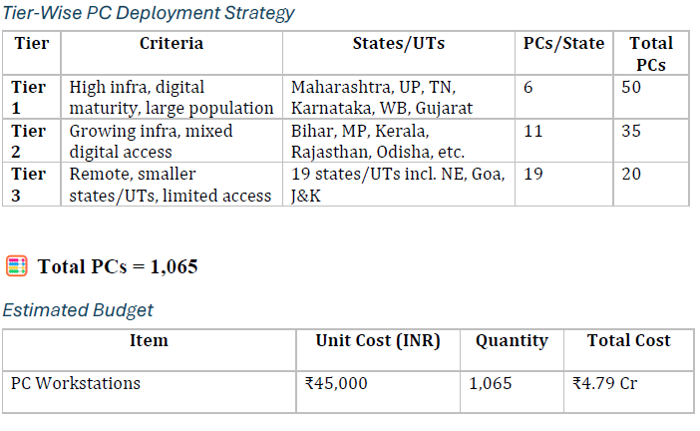
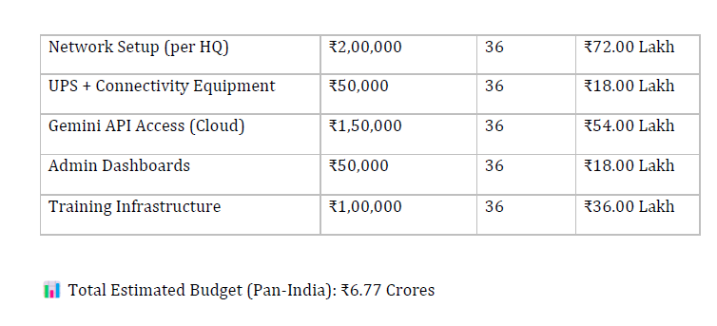
Training and implementation cost State wise

Slide 30
Estimated Budget -

Slide 31
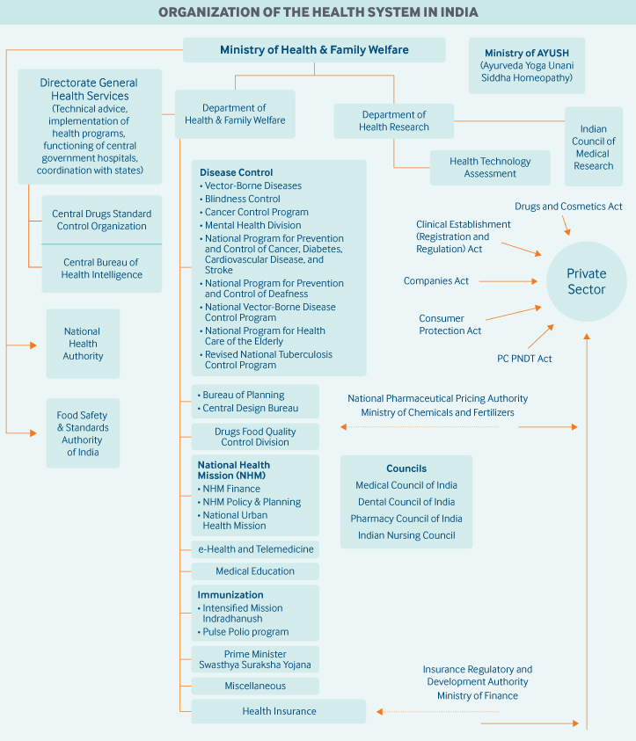

Slide 32
The Government of India (GoI) has laid out several initiatives to promote and develop AI in India, including:
National Strategy for AI (2018) Pg 13
Principles of Responsible AI (2021)
National AI Mission under PM-STIAC (2022).
Ayushman Bharat Health Account
Milestoner | Milestone description | Healthcare use case
Milestone 1 (M1) | This milestone involves creating a verified Ayushman Bharat Health Account (ABHA) during patient registration. | -
Milestone 2 (M2) | This milestone involves linking a patient’s health records with the ABHA ID, allowing the patient to access their own health records | GenAI can help in summarising longitudinal health records for easy consumption and real-time insights for patients.
Milestone 3 (M3) | This milestone involves developing health information user (HIU) services that can enable viewing of a patient’s health history by healthcare personnel. | GenAI can help in selectively obfuscating patient data when it is shared across health institutions.

Slide 33
Parameter | ChatGPT | DeepSeek | Gemini | Grok | Copilot | Claude | Meta | Conclusion
Forecasting Accuracy | Uses historical data to provide reliable financial forecasts. | Excels in deep data analysis, producing highly accurate financial projections. | Integrates real-time data for dynamic and precise forecasting. | Processes large datasets for immediate financial predictions. | Not specifically designed for financial forecasting. | Focuses on ethical and responsible financial forecasting. | Provides reliable but generalized financial forecasting. | DeepSeek and Gemini are superior in forecasting due to their advanced data analysis capabilities.
Real-Time Budget Adjustments | Limited ability to process real-time data; relies on pre- trained models. | Handles structured real-time financial data for quick adjustments. | Provides real- time budget updates based on market trends and internal data. | Processes financial data streams dynamically for immediate budget modifications. | Not applicable; not designed for financial management. | Ensures ethical real- time budget updates with compliance checks. | Supports real- time budget adjustments with a focus on reliability. | Gemini and Grok lead in real-time budget adjustments, with Grok excelling in dynamic scenarios.
Risk Analysis | Identifies potential budgetary risks based on historical data trends. | Specializes in anomaly detection and financial risk forecasting. | Simulates various economic conditions to assess and mitigate risks. | Processes real-time financial data to identify risks proactively. | Not applicable; does not focus on financial risk management. | Prioritizes ethical consideration s in risk assessments | Provides reliable risk assessment insights with transparent methodologie s. | DeepSeek excels in risk analysis due to its anomaly detection and forecasting capabilities.
Cost Optimization | Assists in optimizing budget allocations based on efficiency and need. | Uses deep data insights to recommend optimal budget distributions. | Leverages AI to enhance cost- effectiveness through strategic allocation. | Automates cost analysis and budget redistribution based on real- time changes. | Not applicable; not designed for financial applications. | Ensures ethical and safe cost- optimization strategies. | Focuses on maximizing budget efficiency with reliable financial planning. | Gemini and DeepSeek provide the most effective cost optimization strategies.
Integration with Financial Tools | Integrates with basic financial tools but may require customization . | Offers seamless API integrations for enterprise financial applications. | Supports enterprise- level financial platforms and cloud-based tools. | Designed for integration with real-time financial IoT systems. | Best suited for Microsoft ecosystem financial tools. | Ensures safe and ethical integration with business financial systems. | Focuses on interoperabilit y with various financial software. | Gemini and DeepSeek lead in integration capabilities with enterprise financial tools.
Generative Ai Budget Allocation
Compliance s Ethical Budgeting | Follows ethical budgeting principles but may require manual oversight | Ensures compliance through advanced financial analysis frameworks. | Adheres to strict financial regulations with AI-driven compliance checks. | Provides compliance support but may lack refined financial ethics handling. | Not applicable; does not focus on compliance. | Prioritizes safe and transparent financial compliance. | Ensures ethical financial management with a focus on corporate responsibility. | Claude and Gemini are best for compliance and ethical budgeting due to their focus on responsible AI.

Slide 37
. Methodology
Extensive Literature Survey
Data aggregation
Model algorithm creation
Pre-processing phase
Data preprocessing
Coding
Validation
Statistical Analysis
Simulation of a model

Slide 38
Thank You!
.
17

